Slide 1
Cryptography and Network Security
TRIPLE DES

Slide 2
Session Meta Data
Author | Dr T Sree Sharmila
Reviewer
Version Number | 1.0
Release Date | 6 July 2018

Slide 3
Revision History
Revision Date | Details | Version no.
 |  | 1.0

Slide 4
Agenda
Introduction
Triple DES
Summary
Test your understanding
References

Slide 5
Introduction
A replacement for DES was needed
theoretical attacks that can break it
demonstrated exhaustive key search attacks
AES is a new cipher alternative
Before AES alternative
use multiple encryptions with DES
Triple-DES is the chosen form

Slide 6
Agenda
Introduction
Triple DES
Summary
Test your understanding
References

Slide 7
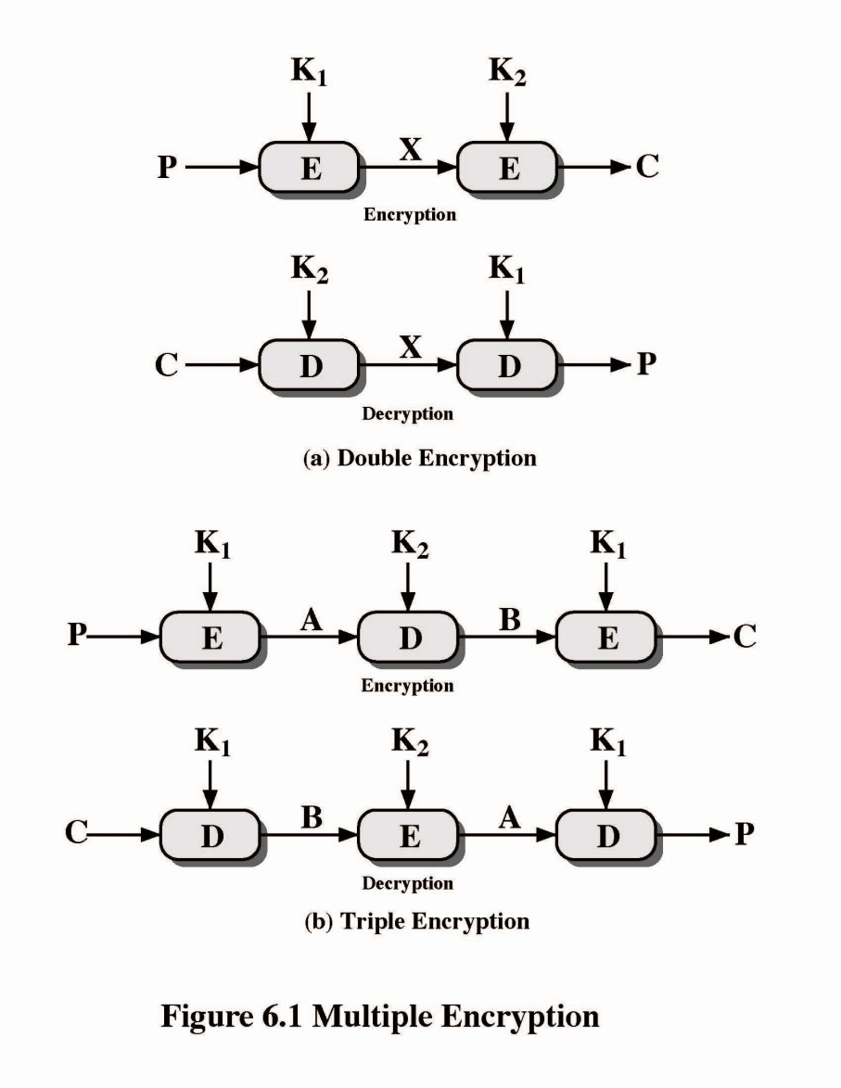
Triple DES

Slide 8
Why Triple-DES?
why not Double-DES?
NOT same as some other single-DES use, but have
meet-in-the-middle attack
works whenever use a cipher twice
since X = E_{K1}[P] = D_{K2}[C]
attack by encrypting P with all keys and store
then decrypt C with keys and match X value
can show takes O(2⁵⁶) steps

Slide 9
Triple-DES with Two-Keys
hence must use 3 encryptions
would seem to need 3 distinct keys
Key of 56 X 3 = 168 bits seems too long
but can use 2 keys with E-D-E sequence
C = E_{K1}[D_{K2}[E_{K1}[P]]]
No cryptographic significance to the use of D in the second step
standardized in ANSI X9.17 & ISO8732
no current known practical attacks
some are now adopting Triple-DES with three keys for greater security
Notes:
Triple-DES with two keys is a popular alternative to single-DES, but suffers from being 3 times slower to run.
Although there are no practical attacks, have some indications of attack approaches.
Hence some are now adopting Triple-DES with three keys for greater security.

Slide 10
Triple-DES with Three-Keys
although are no practical attacks on two-key Triple-DES have some indications
can use Triple-DES with Three-Keys to avoid even these
C = E_{K3}[D_{K2}[E_{K1}[P]]]
has been adopted by some Internet applications

Slide 11
Agenda
Introduction
Triple DES
Summary
Test your understanding
References

Slide 12
Summary
For stream ciphers
For applications that require encrypt/ decrypt of a stream of data
Examples: data communication channel, browser/ web link
For block ciphers
For applications dealing with blocks of data
Examples: File transfer, e-mail, database

Slide 13
Agenda
Introduction
Triple DES
Summary
Test your understanding
References

Slide 14
Test your understanding
Explain Triple DES in detail.
Explain meet-in-the-middle attack.
Briefly explain triple DES with two keys.

Slide 15
References
1. William Stallings, Cryptography and Network Security, 6th Edition, Pearson Education, March 2013.
2. Charlie Kaufman, Radia Perlman and Mike Speciner, “Network Security”, Prentice Hall of India, 2002.

